Slide 1
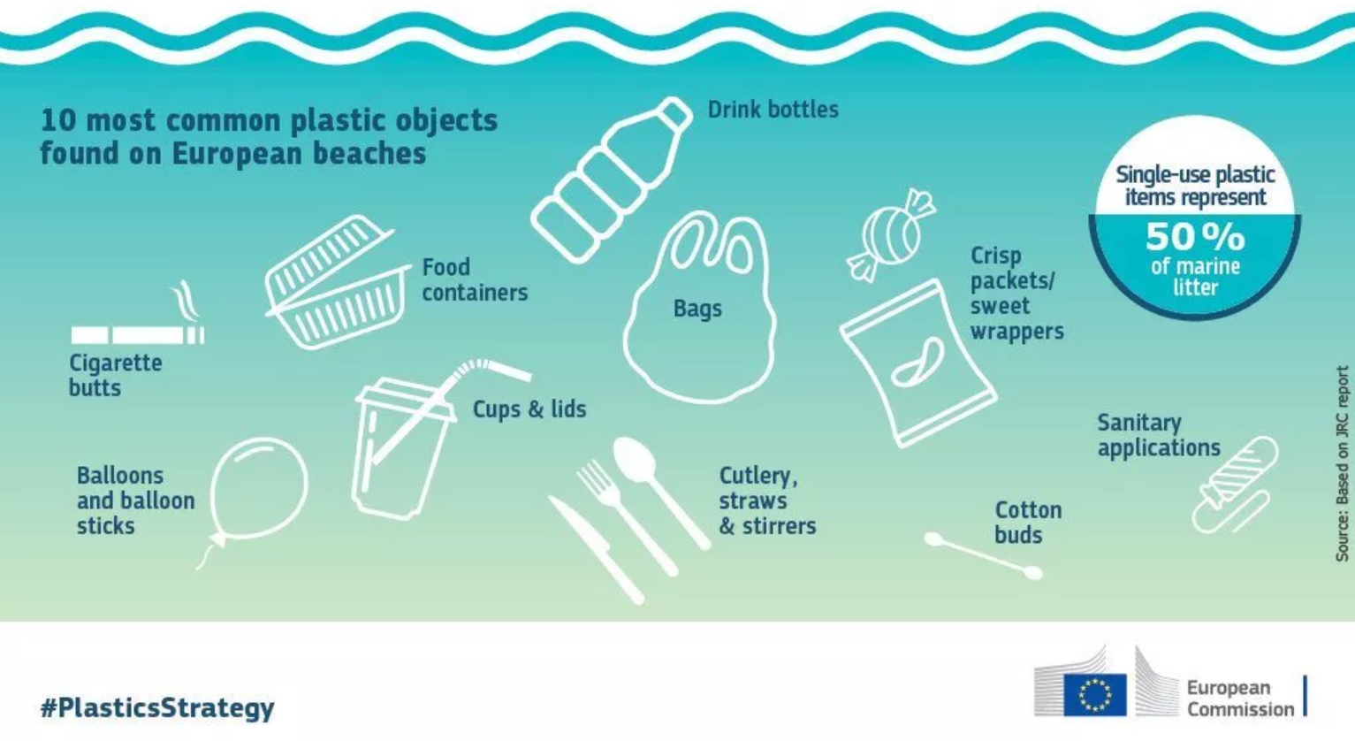
FROM PROBLEM…

Slide 2

…TO SOLUTIONS!

